Slide 1
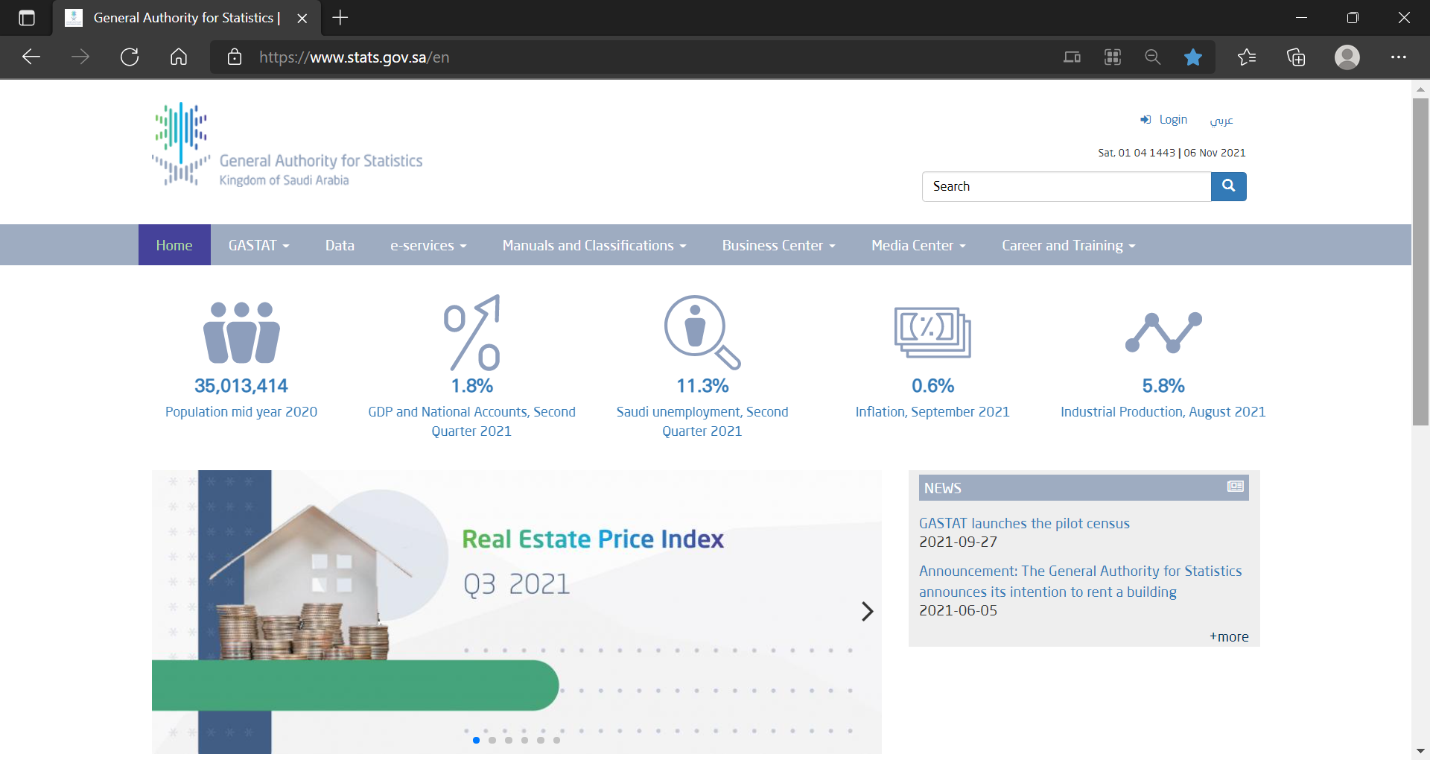
Procedure to obtain PPI data for Saudi Arabia
Go to:
Click on “Data” in the top menu bar
stats.gov.sa/en

Slide 2
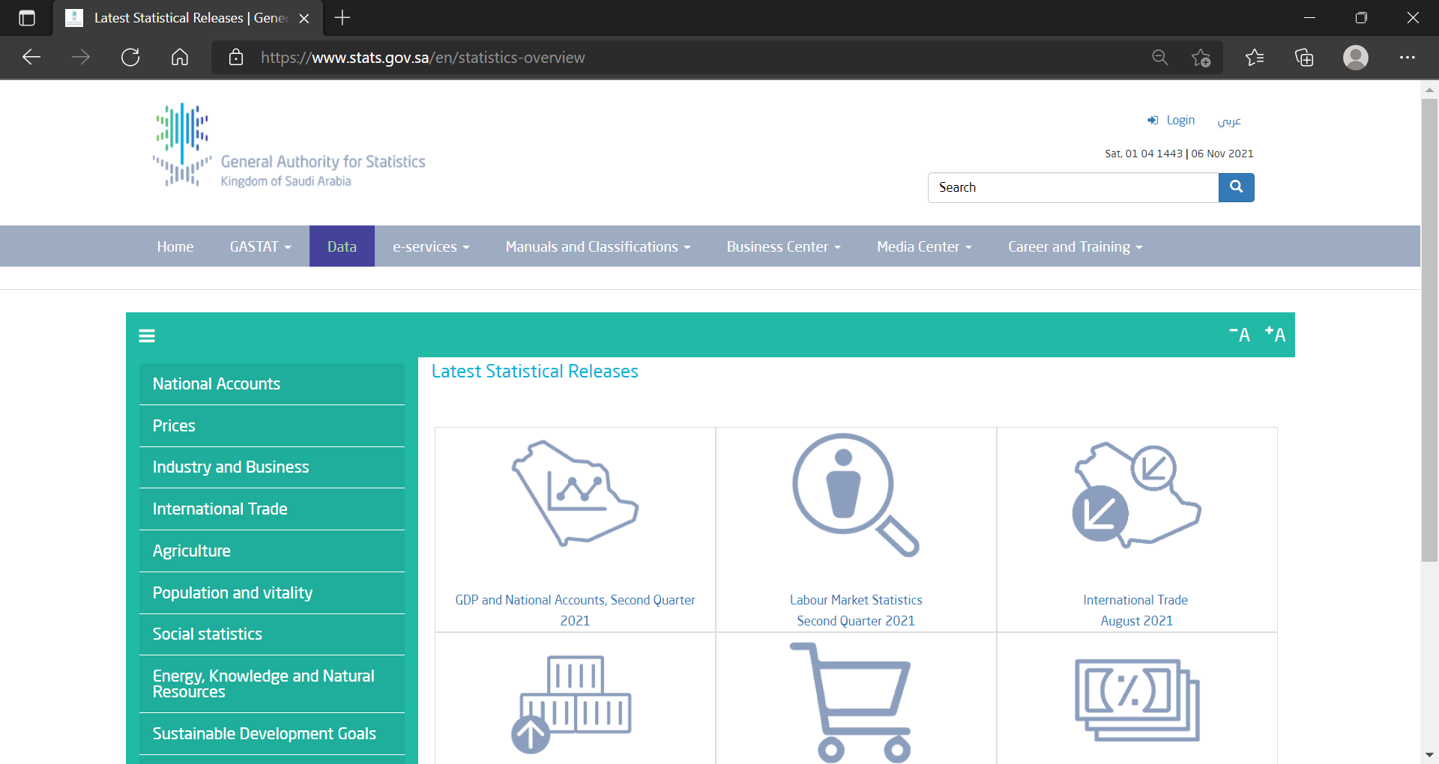
Procedure to obtain PPI data for Saudi Arabia
Click on “Prices” in the left menu

Slide 3
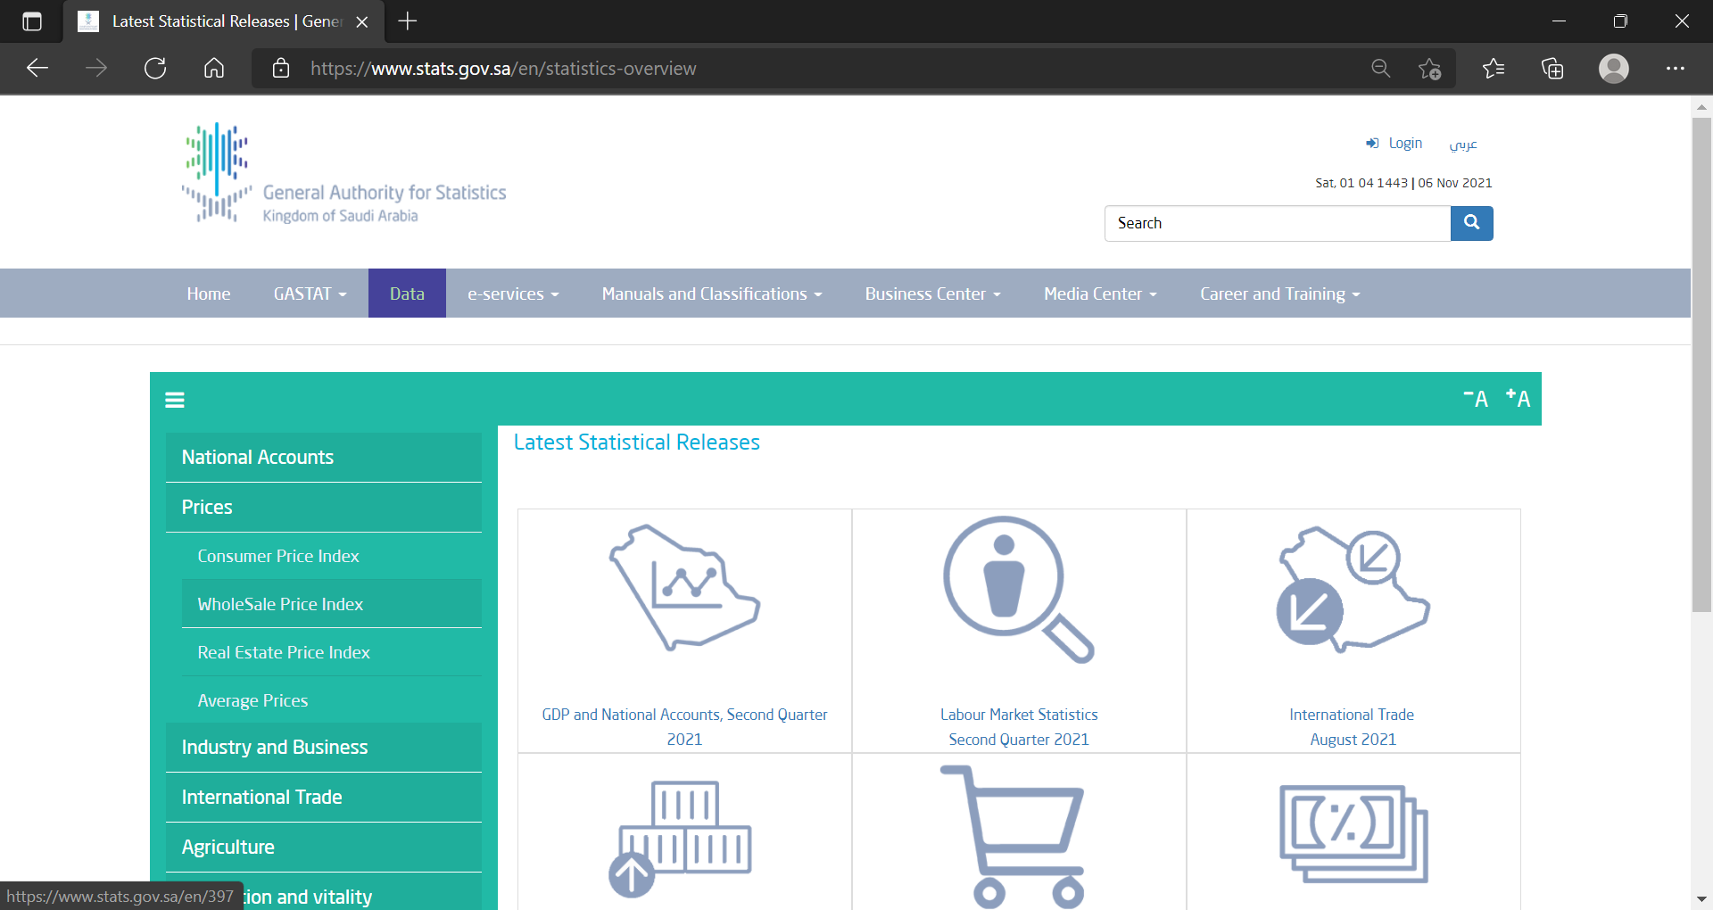
Procedure to obtain PPI data for Saudi Arabia
Click on “Wholesale Price index”

Slide 4
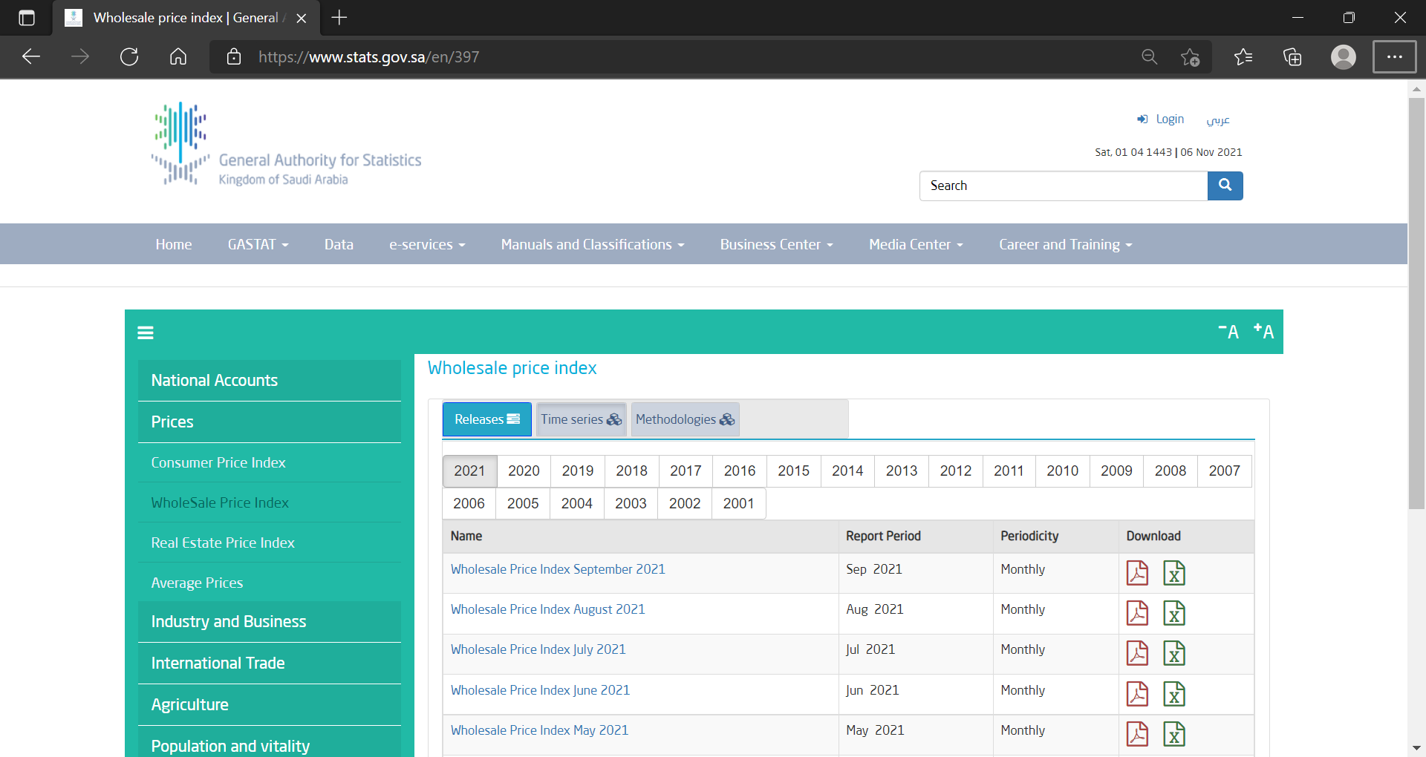
Procedure to obtain PPI data for Saudi Arabia
Click on the Download icon “X” to get the data in Excel format

Slide 5
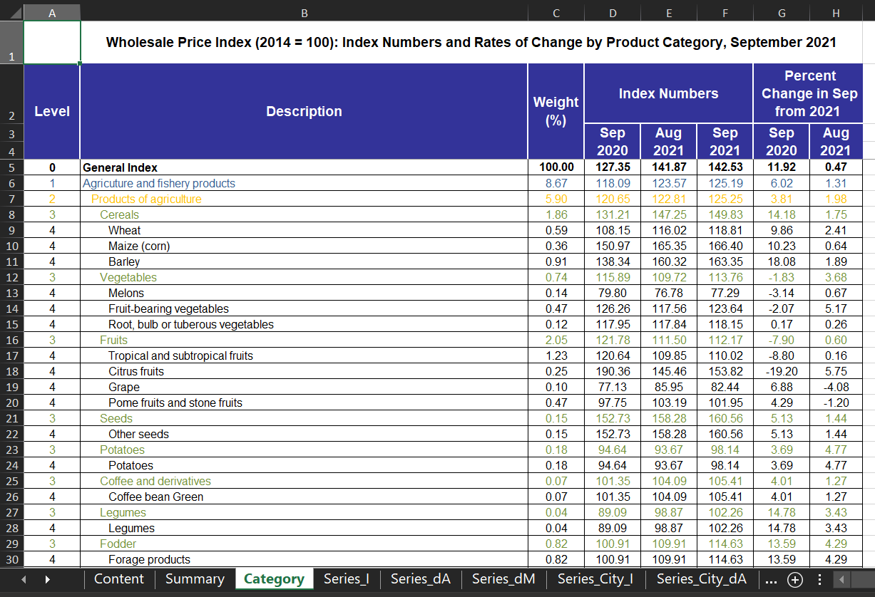
Procedure to obtain PPI data for Saudi Arabia
Open the Excel file titled “WPI_Tables_...”
The tab “Category” contains Price Index data for 197 products for the latest 2 months as well as 12 months prior.
You will need to download previous versions of the Excel file to obtain Price Index data for additional historical months.

Slide 6
Procedure to obtain PPI data for Saudi Arabia
Additional Price Index series for Construction- related materials are available in the section “Average Prices” in the left menu

Slide 7
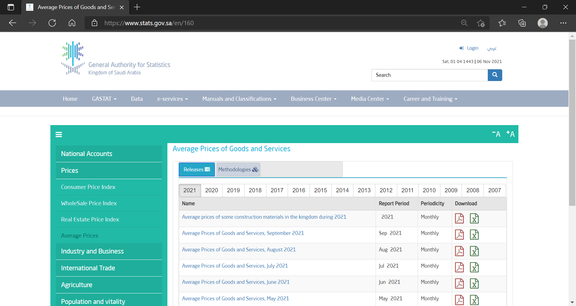
Procedure to obtain PPI data for Saudi Arabia
Click on the Download icon “X” to get the data in Excel format

Slide 8
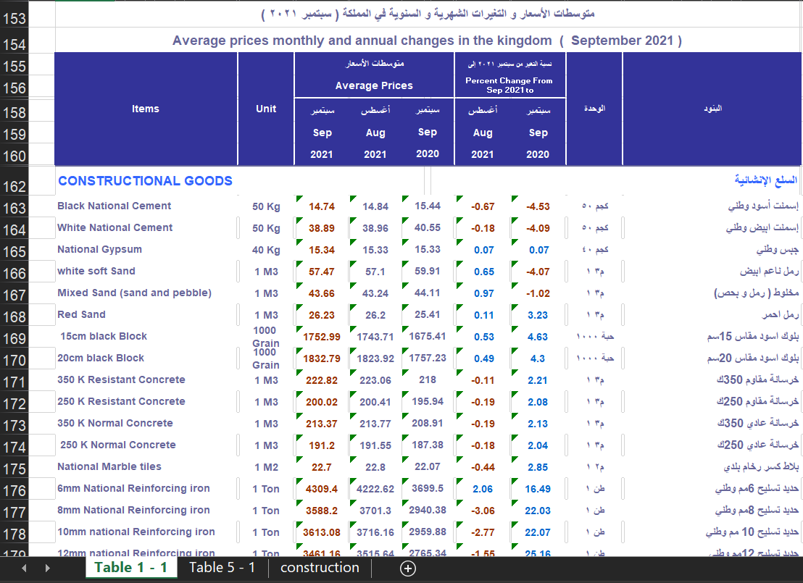
Procedure to obtain PPI data for Saudi Arabia
Scroll down to row 150 to get to the section for Price Index statistics of Construction-related materials

